Slide 1
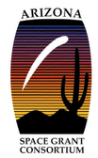
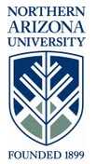
Wind For Schools
Kelsey Morales
Northern Arizona University
Mentors: Allison Kipple
&
Karin Wadsack
NASA Space Grant Symposium
April 21, 2012

Slide 2
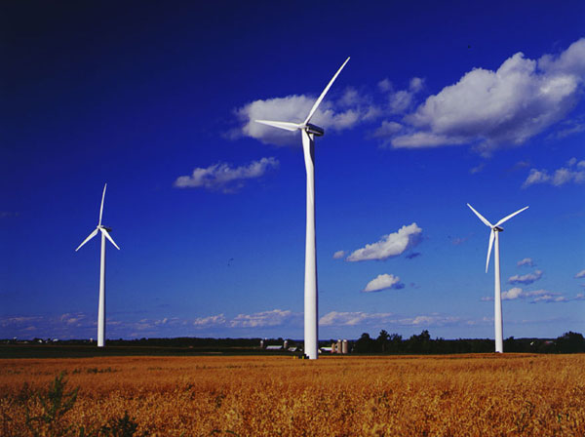
The Importance of Wind Energy
Renewable resource
“Green” energy
Clean energy

Slide 3
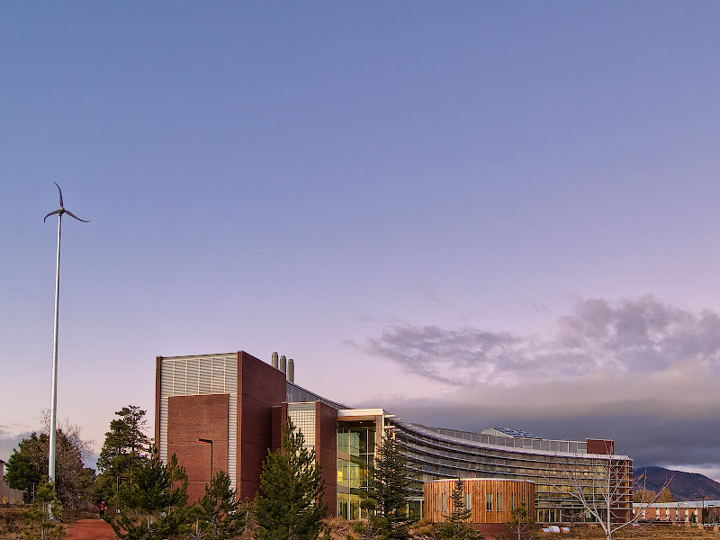
Wind For Schools Program
Originated in 2005 by Wind Powering America and the National Renewable Energy Lab
Project Goals:
  -Install small wind turbines
  -Introduce teachers and students to wind energy

Slide 4
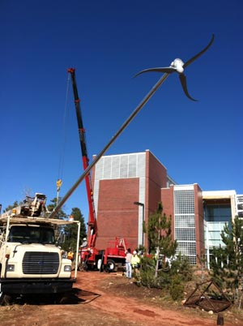
Wind For Schools at NAU
In November of 2011 WFS installed our first Skystream turbine at NAU
Approval for another
Skystream at the
HRM building
Bike Generator
Project

Slide 5
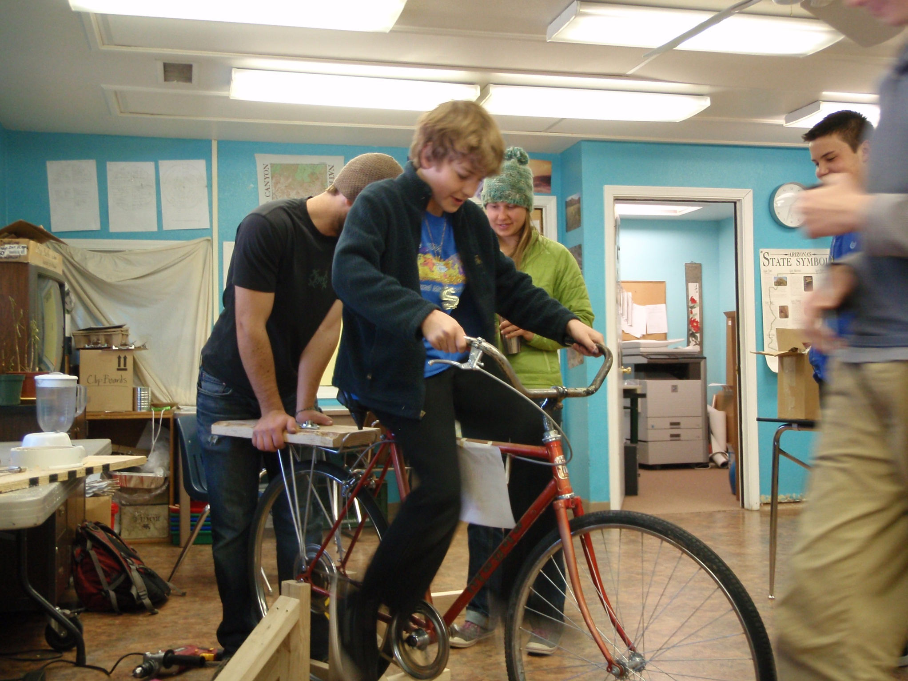

Slide 6
WFS Activities
McGyver
Blade Design
Anemometers

Slide 7
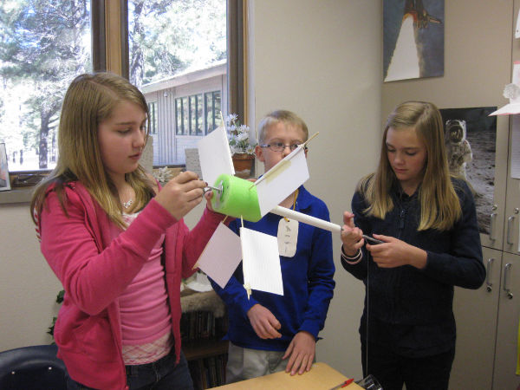
McGyver Activity

Slide 8
Kinsey Intersession
Worked with WACBAT freshman
Prep work
8 day afterschool program
Challenges

Slide 9

WFS Regional Conference
2 day conference at the National Renewable Energy Lab in Boulder, CO
State updates
New projects

Slide 10
Outreach to Schools
Science Fair Nights
-Kinsey Elementary science boot camp
-Sinagua Middle School
Sechrist Elementary School
-K & 4th grade class
-Earth Day Celebration

Slide 11
Conclusion
The WFS program has successfully educated hundreds of students and teachers throughout Arizona about the benefits of wind energy
What WFS has taught me

Slide 12
Acknowledgements
I want to extend a big thanks for all of the guidance and support from my mentors Karin Wadsack and Allison Kipple
NASA Space Grant
Kathleen Stigmon & Dr. Barlow

Slide 13
Questions?

